Slide 1
Fort Worth Botanic Garden
Strategic Plan Summary for
FWBG Task Force
January, 2018

Slide 2
Purposes of Strategic Planning Studies
Strategic Plan
Benchmarking
Financial Recommendations
Governance Recommendations
Master Plan Recommendations

Slide 3
Process
Meetings with FWBG Staff
Meetings with FW Park &Recreation leadership
Meetings with Botanical Society and Garden Club
Meetings with BRIT, Texas Council of Garden Clubs
Public meetings
Website comments
Individual meetings with members of the Public
Presentation and recommendations to City Council

Slide 4
Financial Analysis and Benchmarking

Slide 5
Financial Snapshot
Total Annual Operating Budget: $4.4 million
City support: $2.5 million (including in-kind)
Private support: $1.9 million (primarily earned revenue)

Slide 6
Potential Sources of Revenue for Botanic Gardens
Public Funds
Contributed Funds
Earned Revenues
Endowment Income

Slide 7
Fort Worth Botanic Garden Support

Slide 8
Benchmarking
Peer Group for Benchmarking:
Botanic Gardens with budgets of $3.0 million+
Those receiving at least 5% of revenues from local government

Slide 9
Peer Garden Cities
Atlanta
Brooklyn
Dallas
Denver
Los Angeles
Norfolk
Richmond
San Antonio
San Francisco

Slide 10
FWBG Revenue Sources Compared

Slide 11
Gardens Receiving $2.5 million+ in Public Support
% of Operating Budget
from local government
Fort Worth 58%
Brooklyn 32%
Chicago 32%
Denver 32%
Missouri 33%
New York 19%

Slide 12
Leveraged Private Support
City of Fort Worth leverages 73 cents per public dollar
(Most of this is earned revenue, almost none private philanthropy)
Peer cities leverage $2.42 per public dollar
(From a combination of earned and philanthropic support)
City of Fort Worth leverages only 30% as much as peer gardens in private support

Slide 13
Admission, Memberships, Donors
All, except Fort Worth, have a general admission charge
Average general admission price (adults): $10.00

Slide 14
Financial Analysis
2/3 of operating funds from City
1/3 is earned
Admission fees (only from Japanese Garden and Conservatory)
Facility rentals
Restaurant
Gift Shop
Almost no unrestricted contributions
Almost no endowment

Slide 15
Financial Analysis
Little growth in budget over 10 years
No appreciable change in City support in actual dollars in 10 years
Major loss in in-kind services from City (up to $500K/year in previous years)
Support comes only from two primary sources with little philanthropic support

Slide 16
Unmet Needs - estimated at $1.2 million annually
Major functions not staffed or minimally staffed:
Development and Membership
Finance/Business Operations
Curation
Events
Other functions are understaffed:
Visitor services
Education/ Public Programs
Horticulture
Maintenance and Operations

Slide 17
Capital Repair Needs - estimated $15M-$16M
Conservatory
Garden Center
Rock Springs Building
Lighting (safety/events)
Greenhouses
ADA
Grading/ Drainage

Slide 18
Options to increase operating revenues
1. Increase City support
2. Charge for parking
3. Replace current admission fee for features with a general admission fee
4. Increase philanthropy

Slide 19
Recommendations
City continue its level of support and increase at rate of city salary increases
Change to a general admission fee (from the current policy of separate admission fees for certain features)
Suggested fee of $7-$9/ adult/ children $3-$4
Make adequate provision for low-income FW residents (e.g., Lone Star card holders admitted at children’s fee)
Bring the infrastructure back to full, safe, operating conditions (through general revenue support or bonds)

Slide 20
Current Organizational Structure
Two key support organizations:
Botanical Society
Garden Center Committee (part of Fort Worth Garden Club)

Slide 21
Values to FWBG
Great dedication
Significant revenues primarily through admission fees at Japanese Garden, gift shop, restaurant
Supported certain capital projects
Major volunteer support

Slide 22
Issues
FWBG managed as three separate, almost independent entities
Comprehensive financial management not possible
Long-range planning impeded by structure
Territoriality within the Garden
Inefficiencies and duplication of efforts with problems of coordination
No focus on fundraising
Personnel and cash handling by private entity not in keeping with public sector fund accounting requirements

Slide 23
Recommendation
Create a new non-profit partner comparable to others at major botanical gardens that would focus on:
Private philanthropy for operations, for new gardens and features, & special projects
Build a major base of private support from individuals, foundations, and corporations
Build an endowment

Slide 24
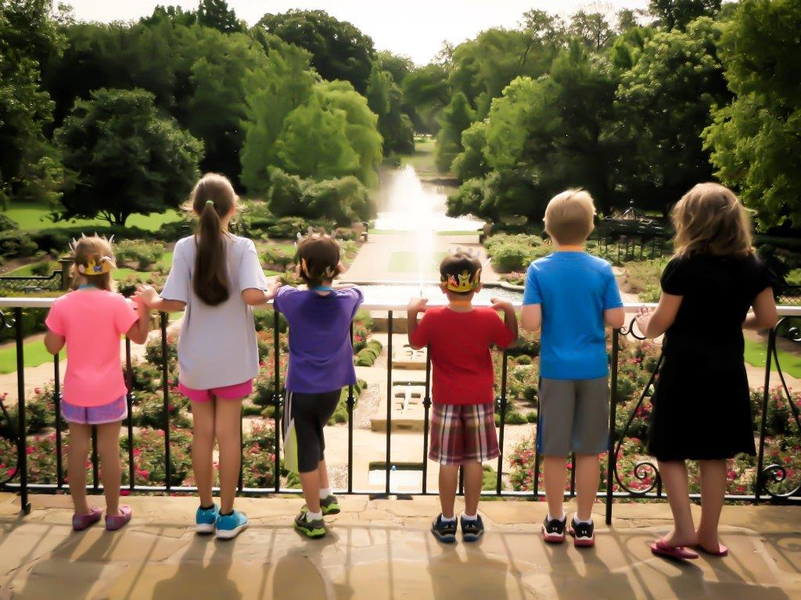
Discussion

Slide 25
Accomplishments
Setup Botanic Garden Special Revenue Fund
Redirect income currently flowing to support groups and for contract maintenance services and operational support
City assumes expenses (and corresponding revenues to fund positions)
Identify needed capital infrastructure costs
Assemble more visitor information
Collaborative agreement with BRIT for joint education and volunteer programs
Notes:
FY2018 Budget included funds from all revenue sources.
FY2017 - $2.86M General Fund
FY2018 - $5.60M Special Revenue Fund
63 Authorized positions
Agreements were executed with support groups so all earned revenues would go to Botanic Garden Special Revenue Fund (BGSRF)
All generated revenues directed to BGSRF; support groups initially retained all remaining generated revenues as of 5/1/17. Subsequent to that, as of 9/30/17, Botanical Society transferred remaining funds to BGSRF.
Hired FWBS nine employees, revenues allowed to add an additional four positions (3.5 FTE); one budget to manage, revenues and expenses
February 21, 2017 CC authorized Execution of a Professional Services Agreement with Elements of Architecture, Inc., in the Amount of $350,000, to Conduct an Assessment of Facility Conditions at the Fort Worth Botanic Garden, M&C C-28127. Report has been received. Staff still reviewing and will present to City Council at later date.
Visitor intercept survey- Began on February 10, 2017. Face-to-face surveys conducted on random days and times. A total of 400 surveys per quarter. Funded at cost of $37K by FWBS and FWGC. Report has been received. Staff still reviewing and will present to City Council at later date.

Slide 26
Contact
Richard Daley
Partner, EMD Consulting Group, LLC
140 Foothills Drive
Hendersonville, NC 28792
rdaley@emdconsulting.com

